Slide 1

ONLINE APPOINTMENT BOOKING (HEALTHCARE)
Zohaib waqar
29 April 2025

Slide 2

Agenda
Introduction
Problem Statement & Scope
Business Requirements Document
Key Business Goals
Functional Requirements Document
Key Functional Requirements
Technical Design Document
Entity Relationship Diagram
Tools Used
BA Techniques Demonstrated
Challenges and Solutions
Conclusion

Slide 3

Digital platform for patients to book, reschedule, and cancel healthcare appointments online

Slide 4

Problem Statement & Scope
Problem:
Manual appointment booking caused double bookings, scheduling errors, lack of reporting​.
Scope:
In-Scope: Appointment scheduling, rescheduling, reminders, reporting​.
Out-of-Scope: Billing automation, patient diagnosis tracking.

Slide 5

Business Requirements Document
Purpose:
Identify business needs and major pain points​​.
Key Artifacts:
Use Case Diagram
System Context Diagram
BPMN Process Flow

Slide 6

Key Business Goals
Eliminate manual inefficiencies
Improve patient experience
Enable data-driven decisions through reporting

Slide 7
FUNCTIONAL Requirements Document
Purpose:
Detail the system's functional requirements​​.
Key Artifacts:
Registration Wireframe
Login Wireframe
Profile Management Wireframe
Appointment Booking Wireframe
Appointment History Wireframe
Reporting Wireframe

Slide 8
Key Functional Requirements
Real-time availability display
Appointment booking & rescheduling
Doctor schedule management
Enable data-driven decisions through reporting
Appointment reminders via SMS
Audit trails for accountability
Role-based access

Slide 9
Technical Design Document
Purpose:
Define architecture, data model, and technology choices​​.
Key Artifacts:
MVC (ASP.NET Core MVC framework)
MS SQL Server Database
Server-rendered HTML/CSS/JavaScript (Razor)​

Slide 10
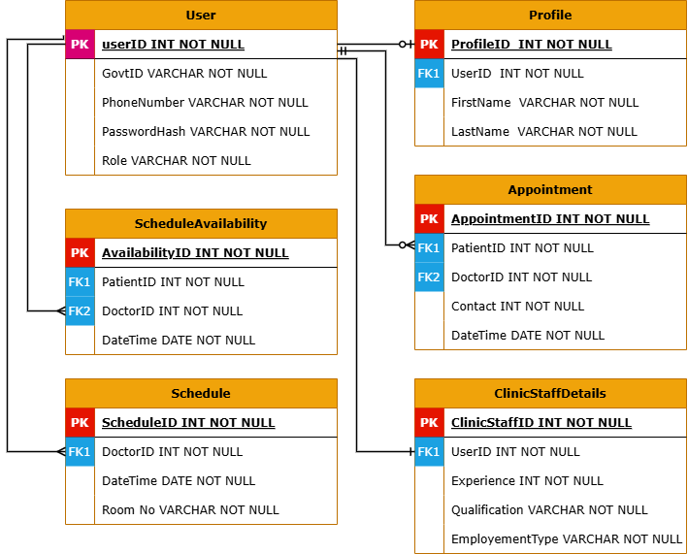
Entity Relationship Diagram (ERD)
Visual overview of entities: User, Profile, Appointment, Schedule​​.
​

Slide 11
REQUIREMENT ELICITATION Tools & TECHNIQUES
The requirement elicitation process involved a multi-faceted approach.
Conducted interviews to understand individual needs
Collaborative workshops to build consensus
Performed detailed document analysis to leverage existing resources
Technical Tools
MS Word
Lucid chart & Draw.io
GitHub

Slide 12

BA Techniques Demonstrated
Requirements Elicitation (questionnaires, analysis)​
Prioritization (MoSCoW)
BPMN for process mapping
Use Case Modeling
Wireframing for UI/UX design
Data Modeling (ERD)

Slide 13
Challenges and Solutions
Challenge
Balancing between detailed requirements and avoiding scope creep
Visualizing real-world scheduling complexity
Solution
Applied MoSCoW prioritization
Detailed wireframes and appointment validation rules​

Slide 14
Conclusion
This project successfully demonstrates the end-to-end capabilities of a Business Analyst from understanding business needs to translating them into structured, actionable documentation.
By clearly defining the business requirements, functional expectations, and technical design, the project reflects a seamless flow from problem identification to solution design.
The process not only highlights core BA competencies such as stakeholder analysis, wireframing, data modeling, and process mapping, but also emphasizes the importance of aligning business goals with system capabilities.

Slide 15

Thank you
Zohaib Waqar
devhub1992@gmail.com

Slide 16

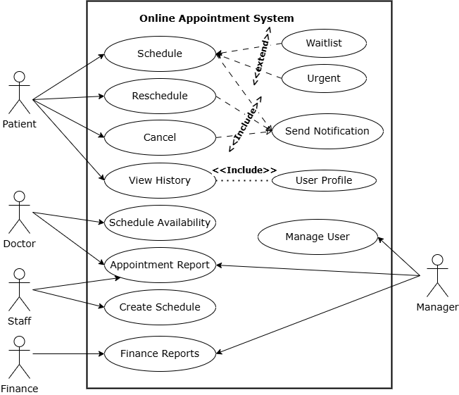
Use Case Diagram
Visual overview of key interactions between users and the system's core functionalities
​

Slide 17
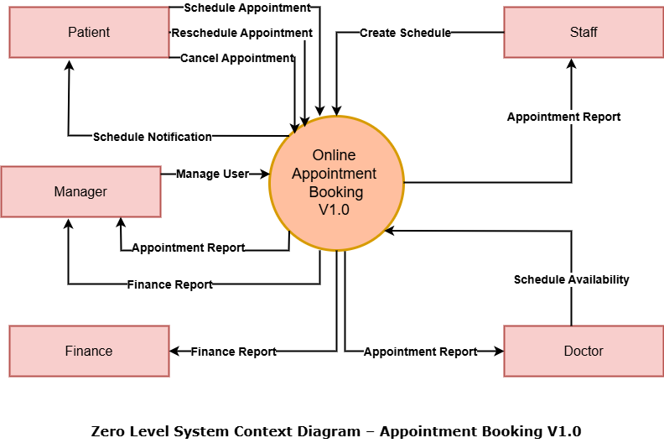
System context Diagram
High-level overview of the system and its interactions with external entities.​

Slide 18
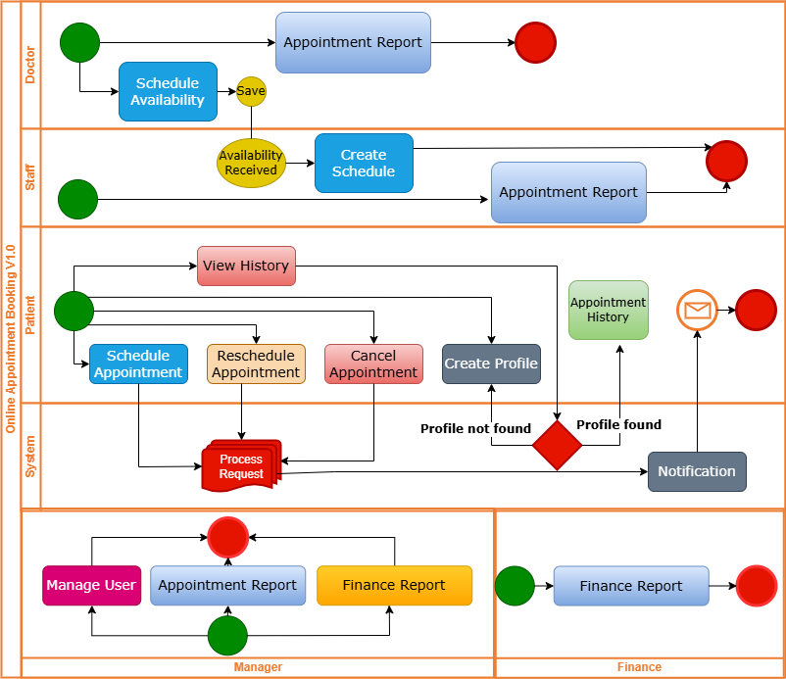
Business Process Model and Notation
End-to-end business process flow, highlighting key activities, decisions, and participants.

